Slide 1

WELCOME TO UNITY

Slide 2
What you will learn in this Course
Basic
Animation & Physics
Implement
- Working with Unity
- GameObjec and basic components
- Animation Scripting and Interactions
- UI Design
- UI Systems
- Applying Scripting and Physics
- Implementing Animations and UI
- Debugging and Troubleshooting
Unity
C#
Animations &
Physics system
Physics Engine
Final Project
Introduction
C# programming
in Unity
L0.1
LO.2
LO.3
LO.4
LO.6
C# in Unity
Physics Engine
- How to use C# in Unity
- C# script and other component of GameObject
- I/O interaction
- Rigidbody
- Collisions & Triggers
- Scoring Systems

Slide 3
Using of Unity
Game development
Interactive Experiences
Previsualization for Film
Architectural Visualization
Animation
Simulations

Slide 4
Module 1
Introduction to Unity Interface and Navigation

Slide 5
Learning Objectives
Familiarize with key components of Unity's interface.
Learn efficient navigation techniques.
Understand the role of various windows and tools.

Slide 6
Content
Introduction to Unity
Layout of Unity
Unity Interface Components
Unity's Scripting Integration
Cross-Platform Capabilities

Slide 7
Introduction to Unity
Unity is a professional-quality game engine used to create video games targeting a variety of platforms. Not only is it a professional development tool used daily by thousands of seasoned game developers, it’s also one of the most accessible modern tools for novice game developers.
1: Hocking, Joseph; Schell, Jesse, Unity in action: multiplatform game development in C#, 2022
9: Tutorials Point, Learning Unity, 2023

Slide 8
Introduction to Unity
Unity is a cross-platform game engine initially released by Unity Technologies, in 2005. The focus of Unity lies in the development of both 2D and 3D games and interactive content. Unity now supports over 20 different target platforms for deploying, while its most popular platforms are the PC, Android and iOS systems.
Unity features a complete toolkit for designing and building games, including interfaces for graphics, audio, and level-building tools, requiring minimal use of external programs to work on projects.
9: Tutorials Point, Learning Unity, 2023

Slide 9
Layout of Unity
Layout of Unity is designed to be both flexible and user-friendly, catering to the diverse needs of game developers. This layout is composed of several key panels or windows, which are introduced in the following slides, each serving specific functions that facilitate the development and testing of games.
This layout is highly customizable, allowing users to drag and rearrange windows to suit their workflow preferences. Users can also save and switch between custom layouts depending on the task at hand, making Unity a versatile tool for game development across various stages of production.
9: Tutorials Point, Learning Unity, 2023

Slide 10
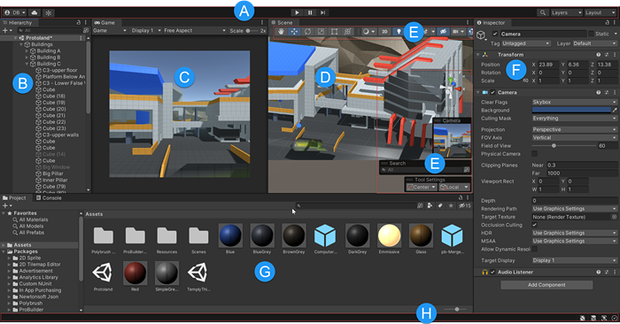
Unity Interface Components
8: Unity Technologies, Unity Manual, 2023
Notes:
• Overview of essential interface elements: Scene view, Game view, Hierarchy, Project panel, Inspector, and Toolbar.
• Explanation of how each component contributes to the game development workflow.
https://docs.unity3d.com/Manual/UsingTheEditor.html

Slide 11
Unity Interface Components
(A) The Toolbar provides access to your Unity Account and Unity Cloud Services. It also contains controls for Play mode; Undo history; Unity Search; a layer visibility menu; and the Editor layout menu.
(B) The Hierarchy window is a hierarchical text representation of every GameObject
in the Scene. Each item in the Scene has an entry in the hierarchy, so the two windows are inherently linked. The hierarchy reveals the structure of how GameObjects attach to each other.
(C) The Game view simulates what your final rendered game will look like through your Scene Cameras. When you click the Play button, the simulation begins.
(D) The Scene view allows you to visually navigate and edit your Scene. The Scene view
can display a 3D or 2D perspective, depending on the type of Project you are working on.
8: Unity Technologies, Unity Manual, 2023

Slide 12
Unity Interface Components
(E) Overlays contain the basic tools for manipulating the Scene view and the GameObjects within it. You can also add custom Overlays to improve your workflow.
(F) The Inspector window allows you to view and edit all the properties of the currently selected GameObject. Because different types of GameObjects have different sets of properties, the layout and contents of the Inspector window change each time you select a different GameObject.
(G) The Project window displays your library of Assets that are available to use in your Project. When you import Assets into your Project, they appear here.
(H) The status bar provides notifications about various Unity processes, and quick access to related tools and settings.
8: Unity Technologies, Unity Manual, 2023

Slide 13
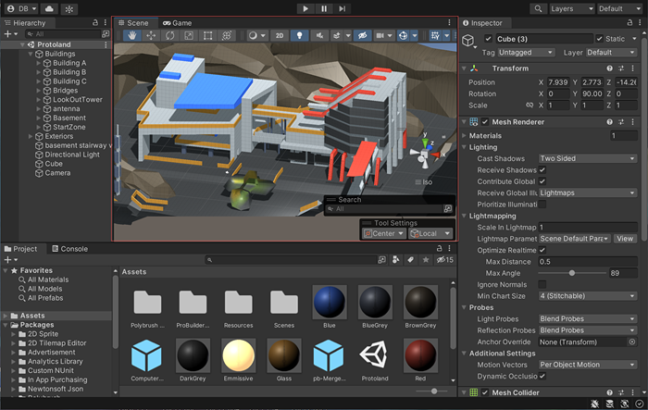
Scene View
8: Unity Technologies, Unity Manual, 2023
Notes:
https://docs.unity3d.com/2021.1/Documentation/Manual/UsingTheEditor.html

Slide 14
Scene View
Purpose: This is where you can visually manipulate and navigate your game world. It allows you to interact with and organize your game objects in 3D space or a 2D plane.
Features: Tools for moving, rotating, and scaling objects; camera controls to view the scene from different angles; and options for toggling visibility and locking objects.

Slide 15
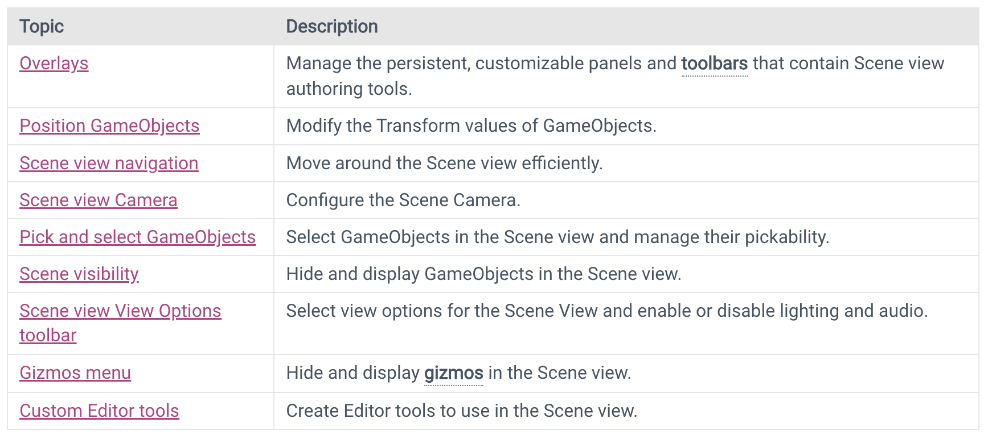
Scene View
The Scene view is where you visualize and interact with the world you create in the Editor. In the Scene view, you can select, manipulate, and modify GameObjects that act as scenery, characters, cameras, lights, and more.

Slide 16
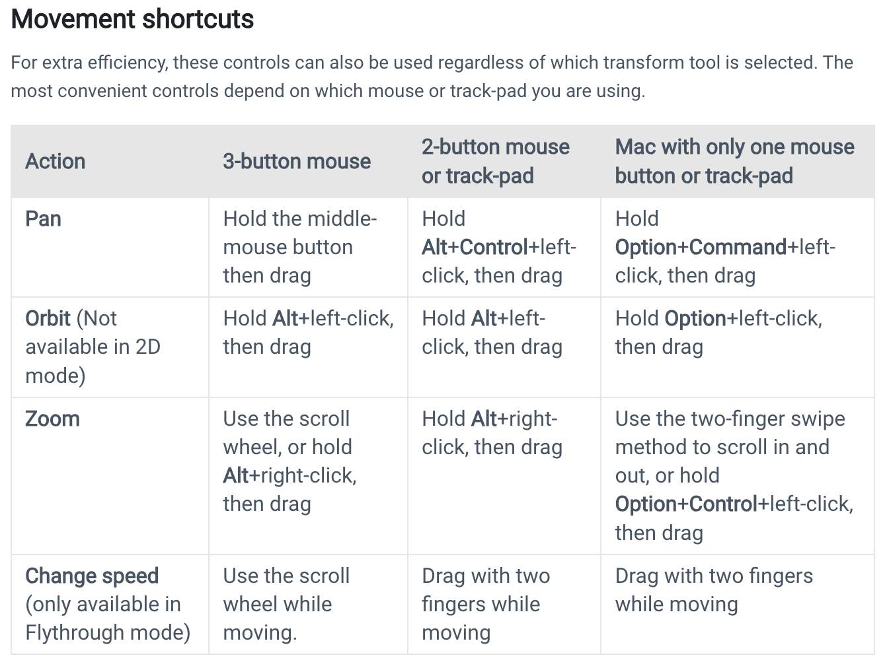
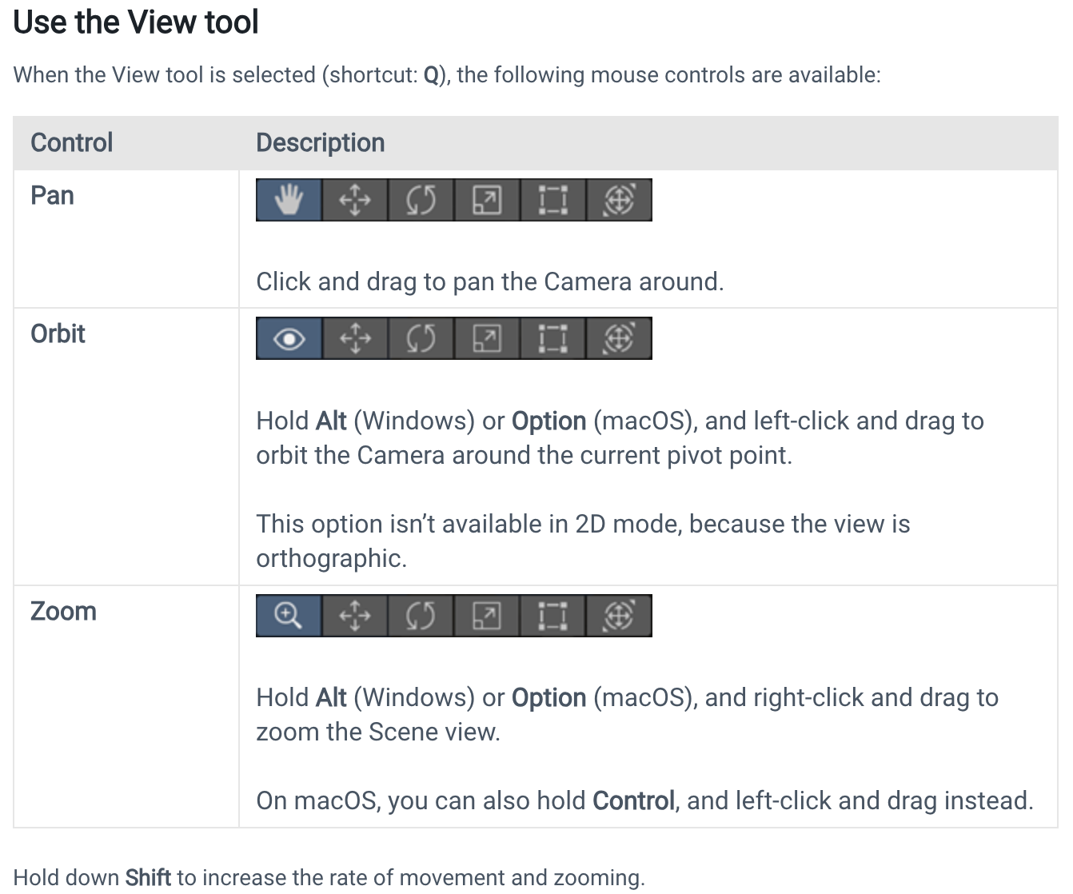
Scene View Navigation

Slide 17
Scene View Navigation
The Scene View - Unity Official Tutorials
Tutorial Video Source: https://www.youtube.com/watch?v=fxJR2pHPyTQ
Notes:
Aims for students to be able to operate on the scene view, using videos to guide basic operations with mouse and keyboard on Unity.
Click on video to start
OR “The Scene View - Unity Official Tutorials” link to open youtube

Slide 18
Game View
Purpose: It provides a preview of what your game will look like to the end-user when it is running. This is the actual player's perspective.
Features: Ability to play, pause, and step through your game right within the editor. It also displays the game from the camera’s point of view.

Slide 19
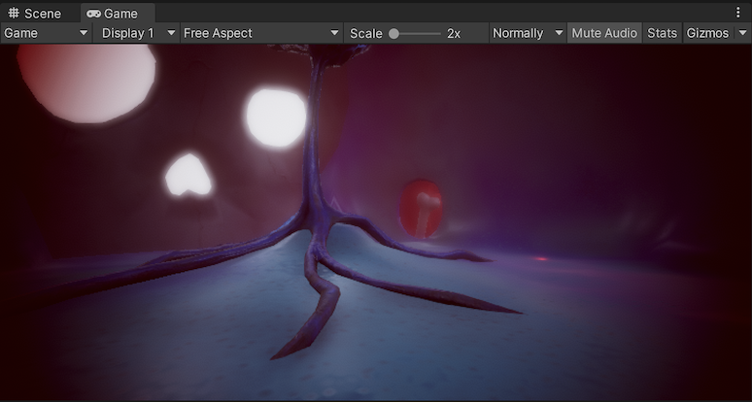
Game View
The Game view is rendered from the Camera(s) in your application. It shows how the final, built application looks. You need to use one or more Cameras to control what the player sees when they are using your application.

Slide 20
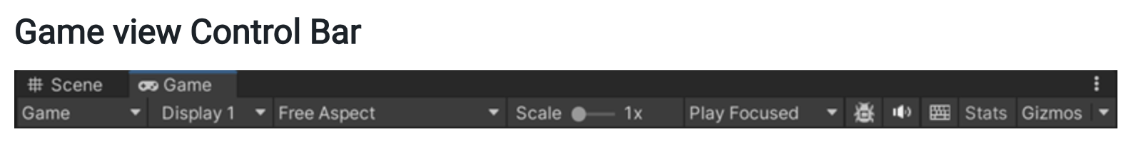
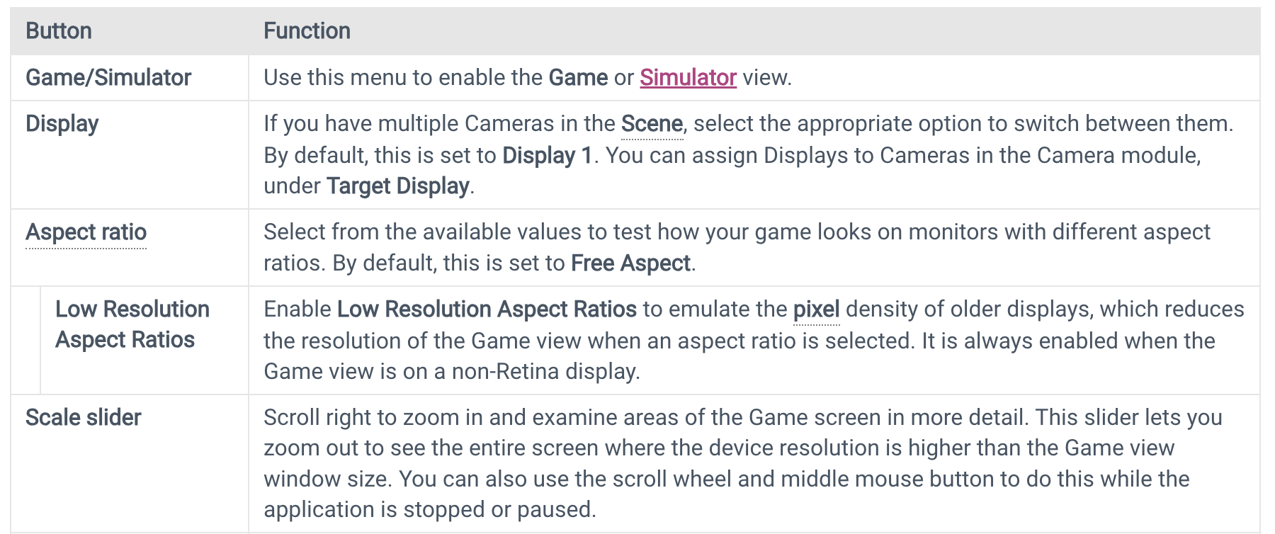
Game View
8: Unity Technologies, Unity Manual, 2023

Slide 21
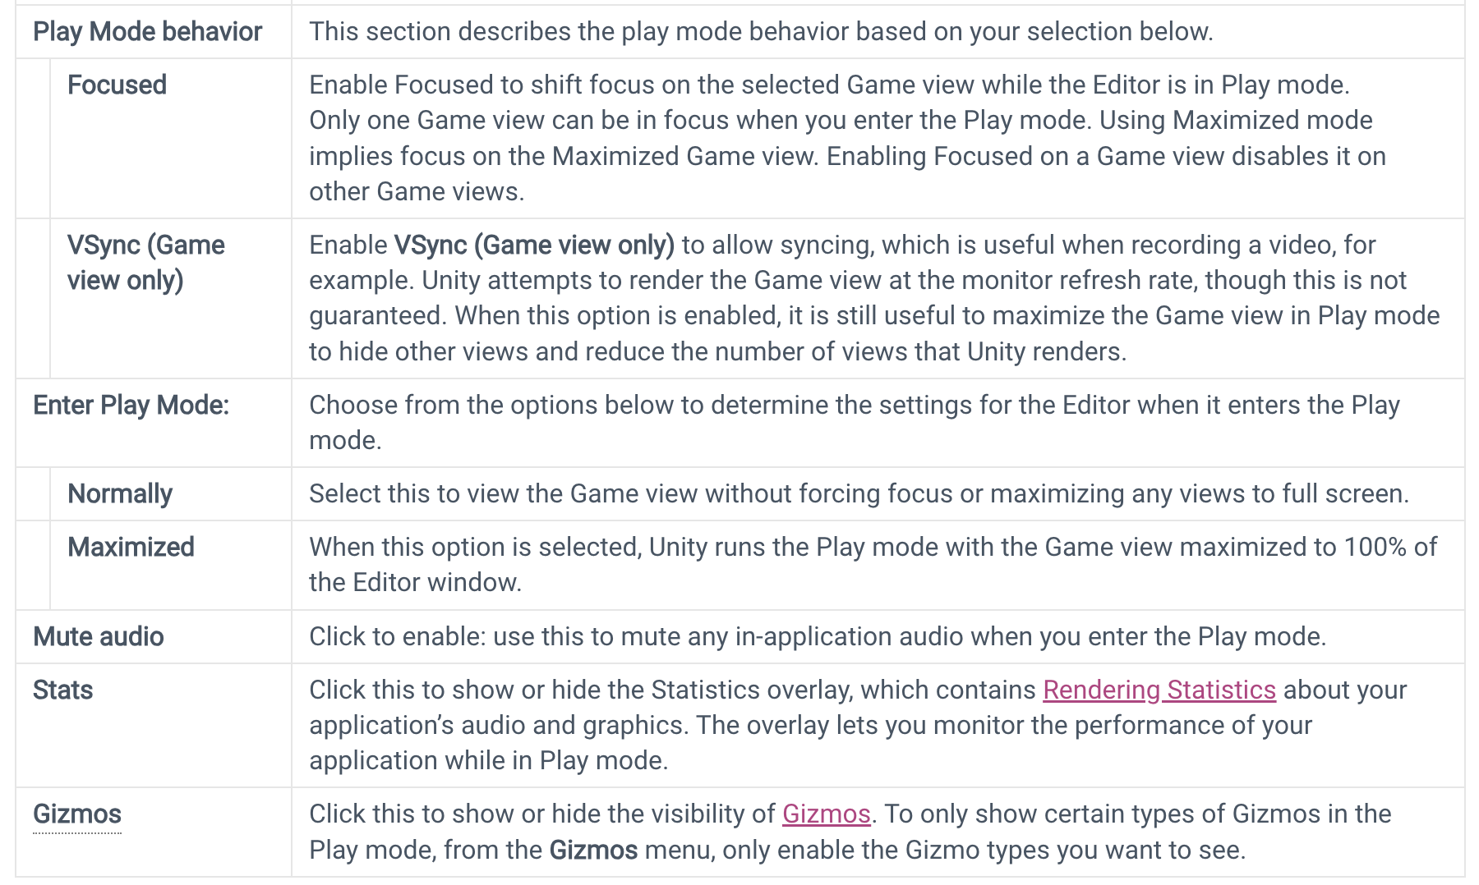
Game View
8: Unity Technologies, Unity Manual, 2023

Slide 22
Hierarchy Window
Purpose: Shows all the game objects in the current scene, both active and inactive. It represents the parent-child relationship between objects, which is crucial for organizing complex scenes.
Features: Easy reordering, searching, and nesting of objects. You can also right-click to create new objects or make them children of others.

Slide 23
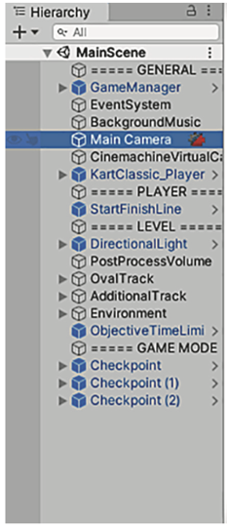
Hierarchy Window
Hierarchy lists the name of every object in the scene and nests the names together according to their hierarchy linkages in the scene.
Basically, it’s a way of selecting objects by name instead of hunting them down and clicking them within the Scene view.
The Hierarchy linkages group objects together visually, like folders, allowing you to move the entire group as one
8: Unity Technologies, Unity Manual, 2023

Slide 24
Inspector Window
Purpose: Displays detailed information about the currently selected object. You can view and edit all properties of a game object here, including components, materials, scripts, and physics properties.
Features: Add new components or scripts; edit properties like color, size, and physical behaviors; apply changes to prefab instances.

Slide 25
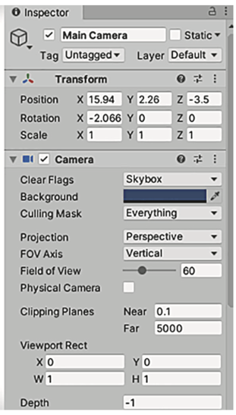
Inspector Window
The Inspector shows you information about the currently selected object. Select an object, and the Inspector is then filled with information about that object. The infor- mation shown is pretty much a list of components, and you can even attach or remove components from objects.
8: Unity Technologies, Unity Manual, 2023

Slide 26
Toolbar
Purpose: Provides quick access to tools for manipulating the scene and game objects, and controls for playing, pausing, and stepping through the game.
Features: Transform tools (move, rotate, scale); play controls; layout selector to switch between custom and pre-set window layouts.

Slide 27
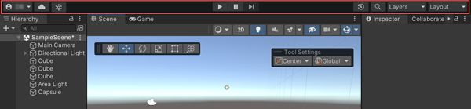
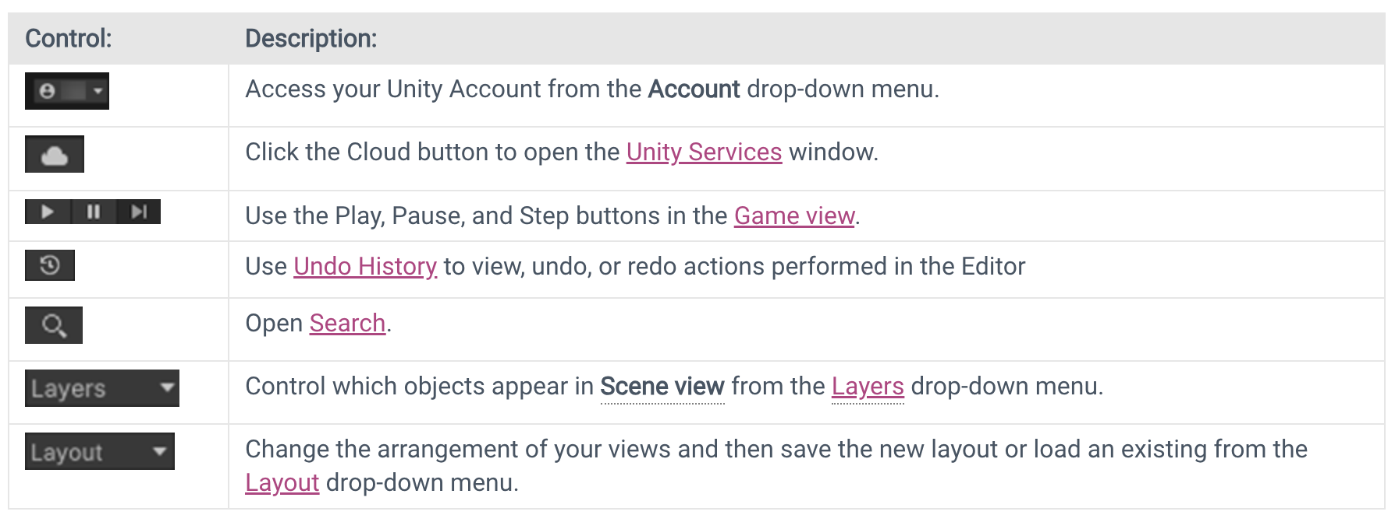
Toolbar
You can find the Toolbar at the top of the Unity Editor. It is not a window, and is the only part of the Unity interface that you can’t rearrange.

Slide 28
Project Window
Purpose: This is essentially your file browser within Unity where you manage all assets associated with your project, such as scenes, scripts, materials, and textures.
Features: Organize assets in folders; import new assets; view and edit asset properties; drag and drop assets into the scene.

Slide 29
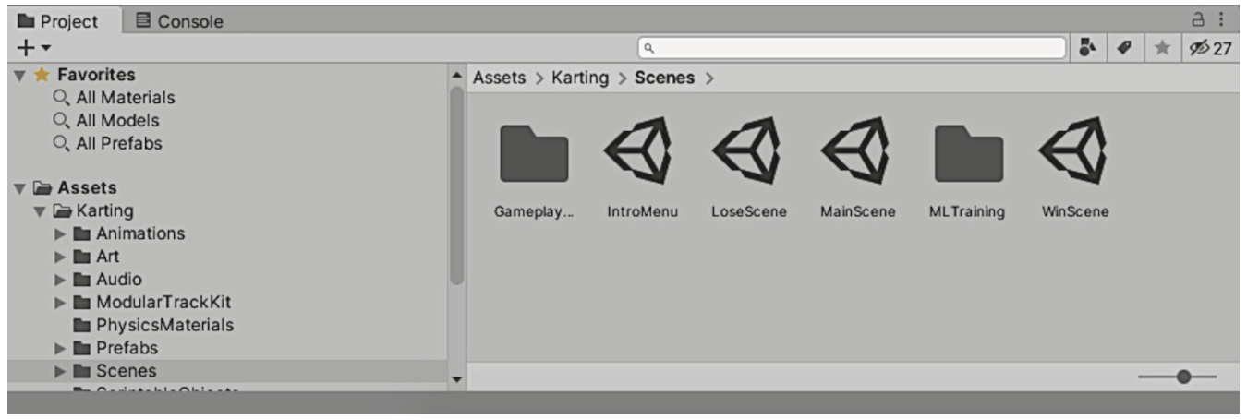
Project window
Project shows all the assets (art, code, and so on) in the project. Specifically, on the left side of the view is a listing of the project’s directories; when you select a directory, the right side of the view shows the individual files in that directory.
Project shows files that may not be contained within any specific scene.
8: Unity Technologies, Unity Manual, 2023

Slide 30
Console Window
Purpose: Displays errors, warnings, and other messages generated by Unity. It is essential for debugging.
Features: Filter messages; clear output; double-click to locate the source of errors in scripts.

Slide 31
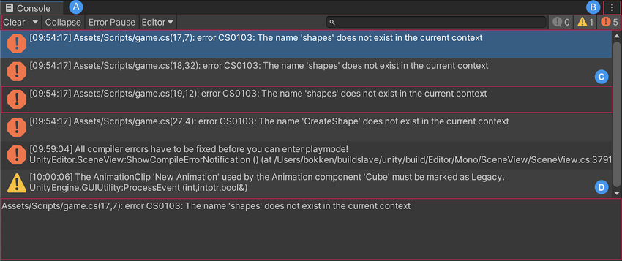
Console window
The Console window is the place where messages from the code show up. Some of these messages will be debugging output that you placed deliberately, but Unity also emits error messages if it encounters problems in the script you wrote.

Slide 32
Animation and Animator Windows
Purpose: These are used to create and manage animations for objects. Animation Window is for keyframe-based animation, while Animator Window manages states and transitions for animation flow.
Features: Timeline for keyframes; curve editor for smooth transitions; state machine setup for complex animations.

Slide 33
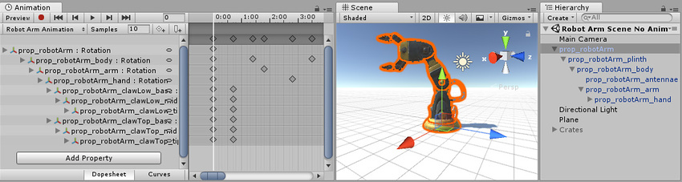
Animation and Animator Windows
The Animation window is linked to the Hierarchy window, the Project window the Scene view, and the Inspector window. Like the Inspector, the Animation window shows the timeline and keyframes of the Animation for the currently selected GameObject or Animation Clip Asset. You can select a GameObject using the Hierarchy window or the Scene View or select an Animation Clip Asset using the Project Window.

Slide 34
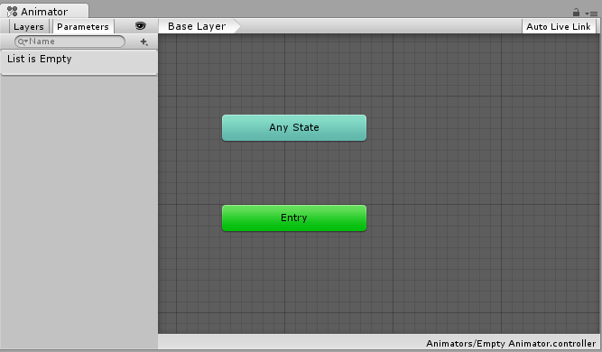
Animation and Animator Windows
The Animator Window allows you to create, view and modify Animator Controller assets.

Slide 35
Unity's Scripting Integration
Unity is deeply integrated with various scripting languages, with C# being the primary language used for scripting game logic within the Unity ecosystem.
Scripts in Unity play a pivotal role in adding interactivity to game objects.
These scripts define the behavior, interactions, and logic behind various game elements, making them dynamic and responsive to player input or events.
Scripts act as the backbone for game interactivity, enabling developers to define how game elements behave and respond in different situations or conditions.

Slide 36
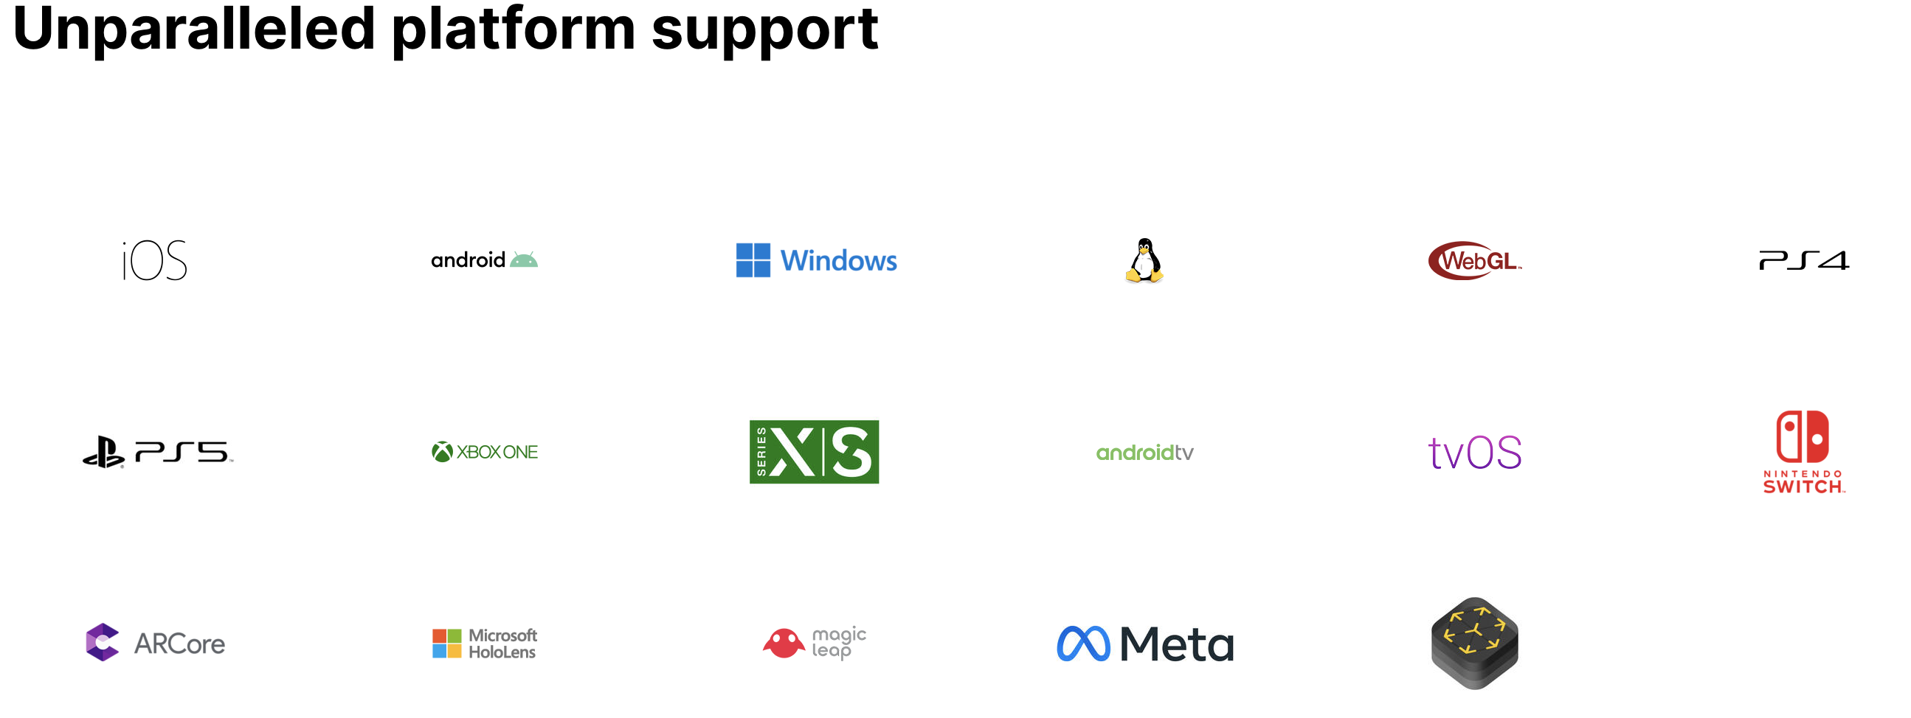
Cross-Platform Capabilities
Unity's cross-platform capabilities empower developers to create games and applications that can seamlessly run on multiple platforms, including mobile devices (iOS, Android), consoles, desktops (Windows, macOS), web browsers, AR/VR devices, and more.
Source: https://unity.com/solutions/multiplatform

Slide 37
Unity Community and Support
Unity Community
Forum: https://forum.unity.com/
Discussions: https://discussions.unity.com/
Community: https://unity.com/community
Unity Manual
https://docs.unity3d.com/ (*)
https://learn.unity.com/
Unity Asset Store
https://assetstore.unity.com/

Slide 38
Summary
Understanding Unity's Interface: Explored the fundamental components—Scene view, Game view, Hierarchy, Project panel, Inspector, and Toolbar—underlining their roles in the game development workflow.
Panel and Tool Roles: Emphasized the significance of each panel and tool, detailing their contributions to game creation, manipulation, and asset management.
Scripting and Cross-Platform Capabilities: Introduced Unity's scripting integration, highlighting the role of scripts in adding interactivity, and discussed Unity's cross-platform adaptability for diverse deployment.

Slide 39
References
1: Hocking, Joseph; Schell, Jesse, Unity in action: multiplatform game development in C#, 2022
3: Geig, Mike, Sams teach yourself Unity Game development in 24 hours, 2014
8: Unity Technologies, Unity Manual, 2023
9: Tutorials Point, Learning Unity, 2023

